Slide 1
Traffic Box Art Design Template: For corner of Frederick and Noyes
This is a flat template of a typical traffic box showing the front, back and sides; it is not to scale. To get a sense for the actual project, visit the box at Frederick and Noyes. Official signage on the box cannot be painted over or obscured otherwise. You must use this template to show your basic design concept. Because the selection committee will review design concepts in their decision-making process, you should show the colors that you would use. It is understood that the design may need to be updated or reworked once selected.
Top of box left blank
Front East Facing 53.5” H X 44” W | Side South Facing 53.5” H X 26” W | Back West Facing 53.5” H X 44” W | Side North Facing 53.5” H X 26” W
FRONT
BACK
Concrete base left as is

Slide 2
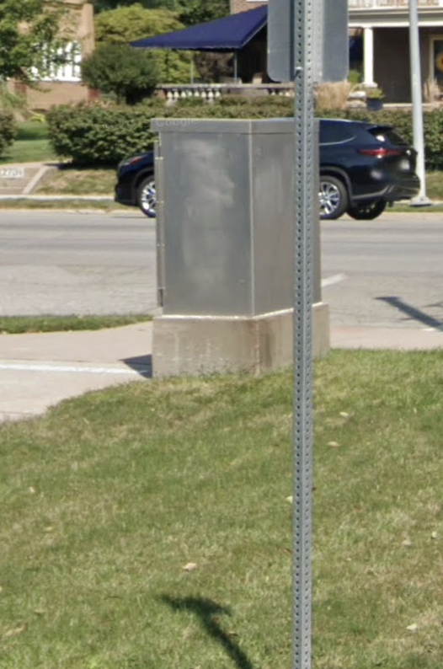
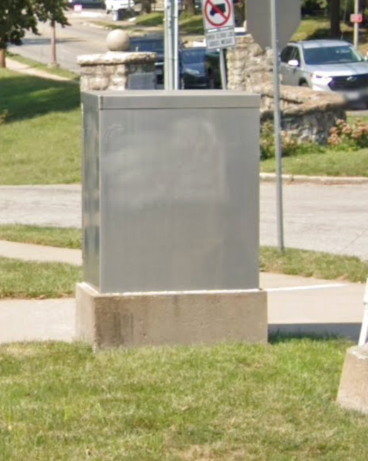
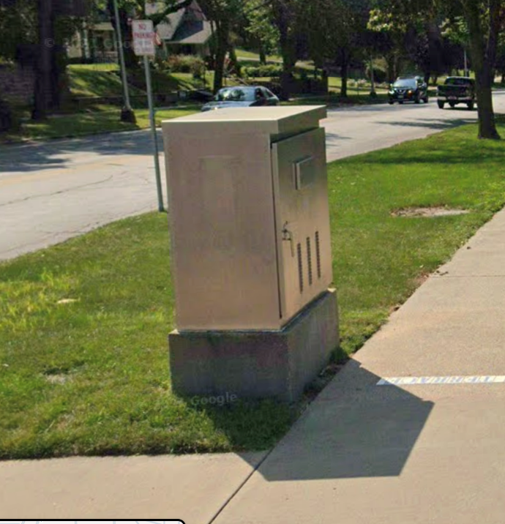
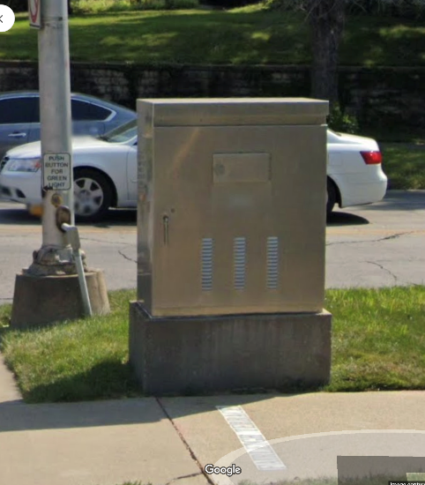
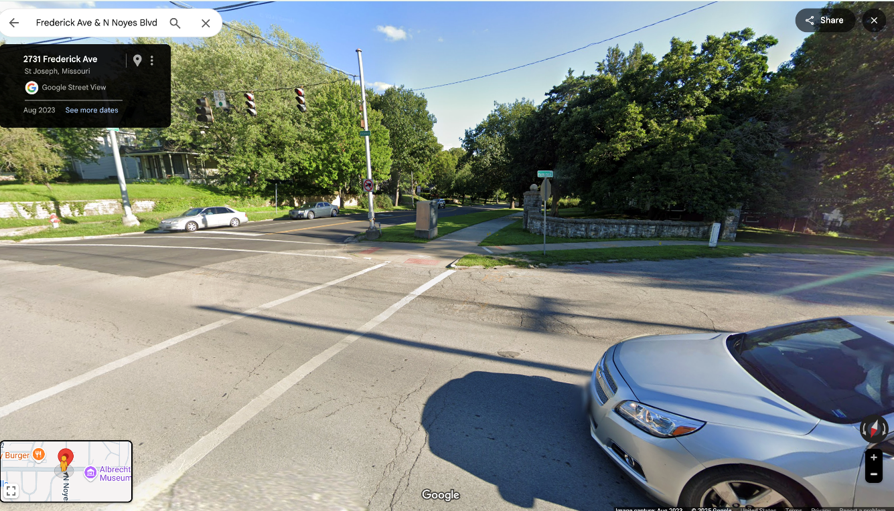
Side View South facing
Front View East facing
Side View North facing
Back View West facing

